Slide 1
DLE Product Team Update October 2023 TI-01

Slide 2
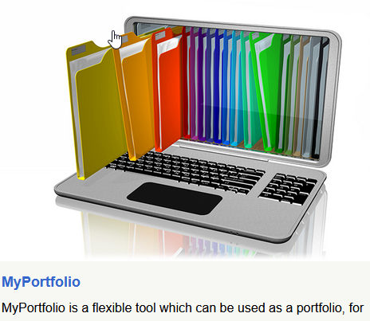
Digital Learning Environments
Mission:
To improve the student experience by empowering our staff to support, deliver and enhance teaching and learning through the use of our DLE platform.
Vision
To provide a robust and accessible sector-leading DLE platform.
For our DLE to be recognised by staff and students as integral to providing value to their teaching and learning experience.
To be known globally for sharing our knowledge, skill and developments with the wider community.

Slide 3
Digital Learning Environments Objectives TI-01
User experience
Objectives/Features | Outcome | Value/benefits
Moodle Course Format Review | Review the use of course formats in Moodle and make decisions on what formats can be moved to Moodle 4 | Reduction of the course formats number would lead to lesser cost and maintenance effort.
Moodle accessibility improvements | Continue to improve upon the accessibility of the new Moodle theme and include evaluation of Moodle plugins in the accessibility statement. Where accessibility requirements are not met, guidance on alternatives will be provided. | Improved compliance with accessibility legislation along with improved the student and staff experience overall.

Slide 4
Digital Learning Environments Objectives TI-01
Plugins and add-ons
Objectives/Features | Outcome | Value/benefits
MyPortfolio Moodle/Mahara Integration | Integrate MyPortfolio (Maraha) with Moodle so that e-potfolios can be set as a new assessment type within Moodle. | An integration with Moodle provides simplified workflows for assessment and authentication.
Cadmus - LTI Configuration | Support for Cadmus assessment PoC. Requires integration with Moodle. Test integration and make available to for functional testing by others outside DLE.
Moodle Quiz Gradebook training packages created and delivered | Produce fully online and face-to-face two training courses ( Moodle Quiz and Gradebook) for tutors and administrators with workshop and online course content. | Easy knowledge transfer with a training/support tool for Moodle course administrators which frees resources in the DES team.

Slide 5
Digital Learning Environments Objectives TI-01
Data integrations
Objectives/Features | Outcome | Value/benefits
SITS/Moodle integration Mark Transfer PILOT | Gather user feedback on the feature set; prioritised list of the features/functionality; Make go/no-go decision on MVP release; implement top priorities ref: assessment wizard (epic) | Better, faster and more efficient services to our stakeholder groups will significantly transform operational activities and reduce the burden on course administrators and tutors responsible for the transfer of grades to SITS.
Course Life Cycle re-work | The Course Life Cycle tool introduced in 2022 has a large number of backlog items that need to be reviewed, prioritised and worked through to implement user enhancements, and bug fixes. | Overall improvements to the tool.

Slide 6
Digital Learning Environments Objectives TI-01
Operations
Objectives/Features | Outcome | Value/benefits
DLE Operations | Day-to-day operational support and monitoring, fixes, testing and deployments. RemedyForce support, BAU reporting, and infrastructure maintenance. | Maintenance of a complex system to ensure value for stakeholders.
Moodle upgrade 4.3 | Codebase fixes and testing done. Upskill team members on upgrade/deployment. | The latest features and fixes are in place. i.e., large-scale performance enhancements and additions to the quiz feature.

